Slide 1
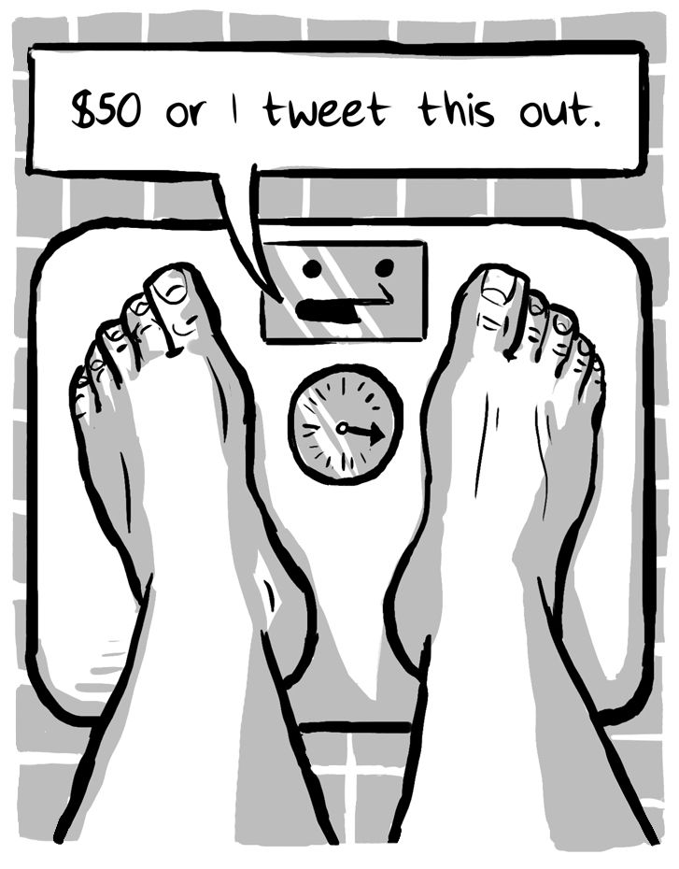

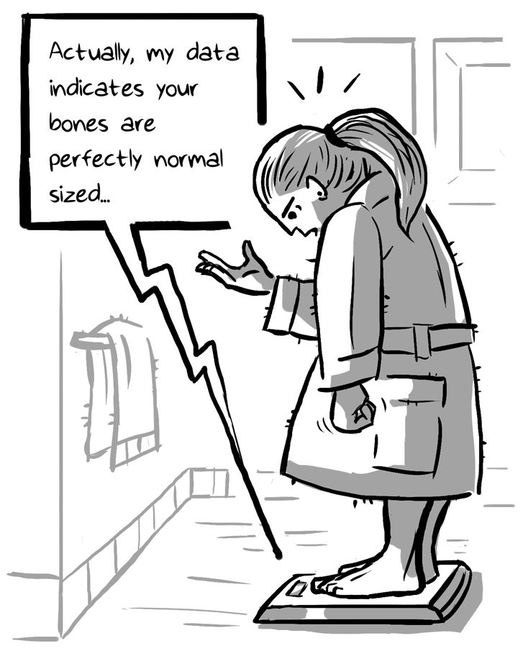
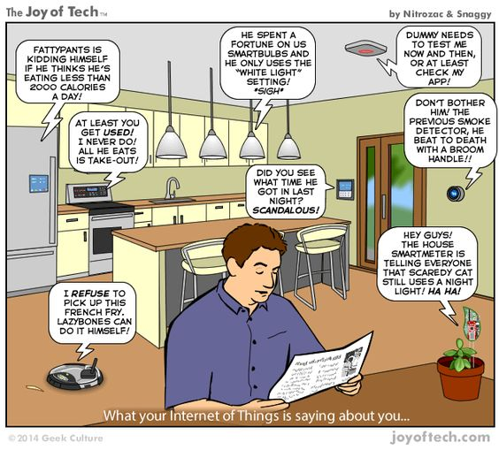
Internet of Things
Hands-On
Govind G N,Mayur Patil,
Faculty, CSE Dept,
SDMCET, Dharwad, Karnataka, INDIA

Slide 2

http://blog.atollic.com/one-trillion-iot-devices-expected-by-2025-what-development-tools-to-use-for-development-of-internet-connected-iot-products

Slide 3
What is IoT?
The Internet of Things (IoT) is the network of physical objects—devices, vehicles, buildings and other items—embedded with electronics,software, sensors, and network connectivity that enables these objects to collect and exchange data
IoT allows objects to be sensed and controlled remotely across existing network infrastructure, creating opportunities for more direct integration of the physical world into computer-based systems, and resulting in improved efficiency, accuracy and economic benefit
The daily operation of IoT system requires that we collect right information about what’s going on.

Slide 4

http://blog.claricetechnologies.com/2014/03/demystifying-the-internet-of-things/

Slide 5
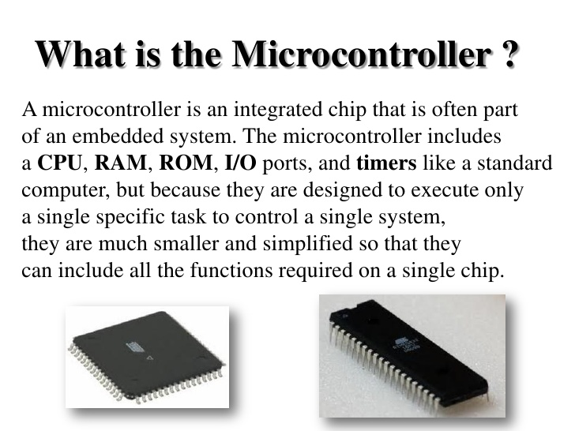
Microcontroller-based devices are more constrained & your application code run directly on the processor without the support of an OS.

Slide 6
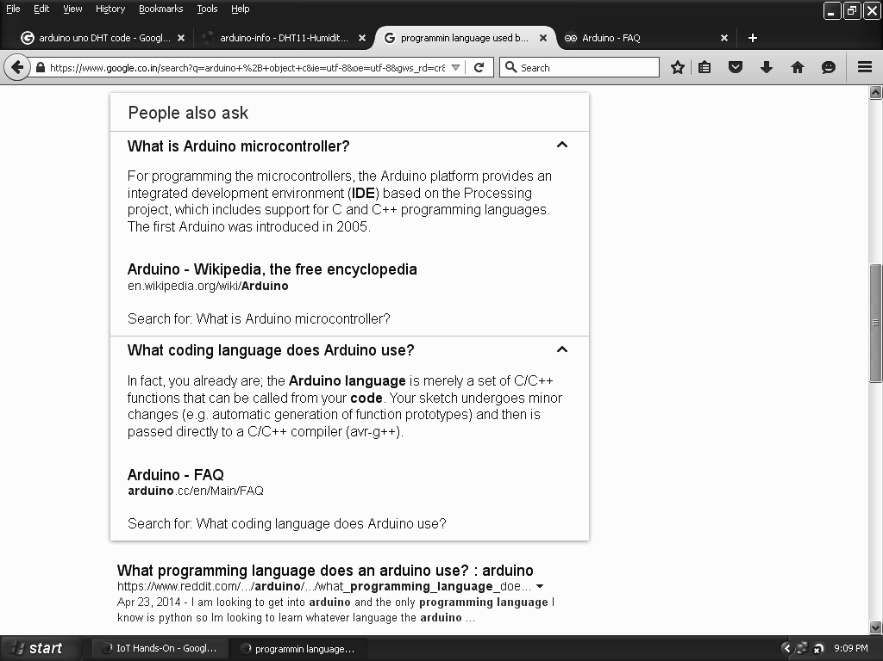

Slide 7


Slide 8
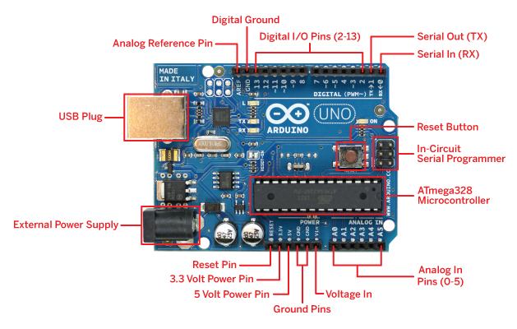
Arduino Pinout - https://www.arduino.cc/en/Main/FAQ
8-bit CPU
The ATmega328 is a single-chip microcontroller created by Atmel in the megaAVR family.

Slide 9
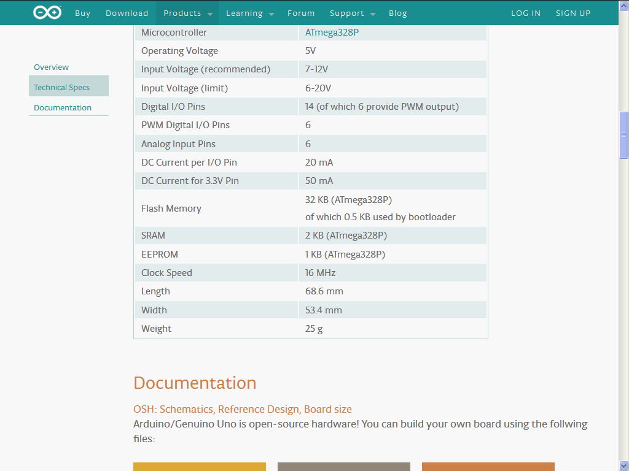
Arduino Uno Specifications
Pulse Width Modulation, or PWM, is a technique for getting analog results with digital means. Digital control is used to create a square wave, a signal switched between on and off.
For example, we can use PWM to change the brightness of an LED; the wider the “ON” pulses, the brighter the LED glows.

Slide 10
analogReference()
Description
Configures the reference voltage used for analog input (i.e. the value used as the top of the input range). The options are:
DEFAULT: The default analog reference of 5 volts (on 5V Arduino boards) or 3.3 volts (on 3.3V Arduino boards)
INTERNAL: Built-in reference, equal to 1.1 volts on the ATmega168 or ATmega328 and 2.56 volts on the ATmega8(not available on the Arduino Mega)
EXTERNAL: The voltage applied to the AREF pin (0 to 5V only) is used as the reference.
Syntax
analogReference(type)
Parameters type: which type of reference to use (DEFAULT, INTERNAL, INTERNAL1V1, INTERNAL2V56, or EXTERNAL)

Slide 11
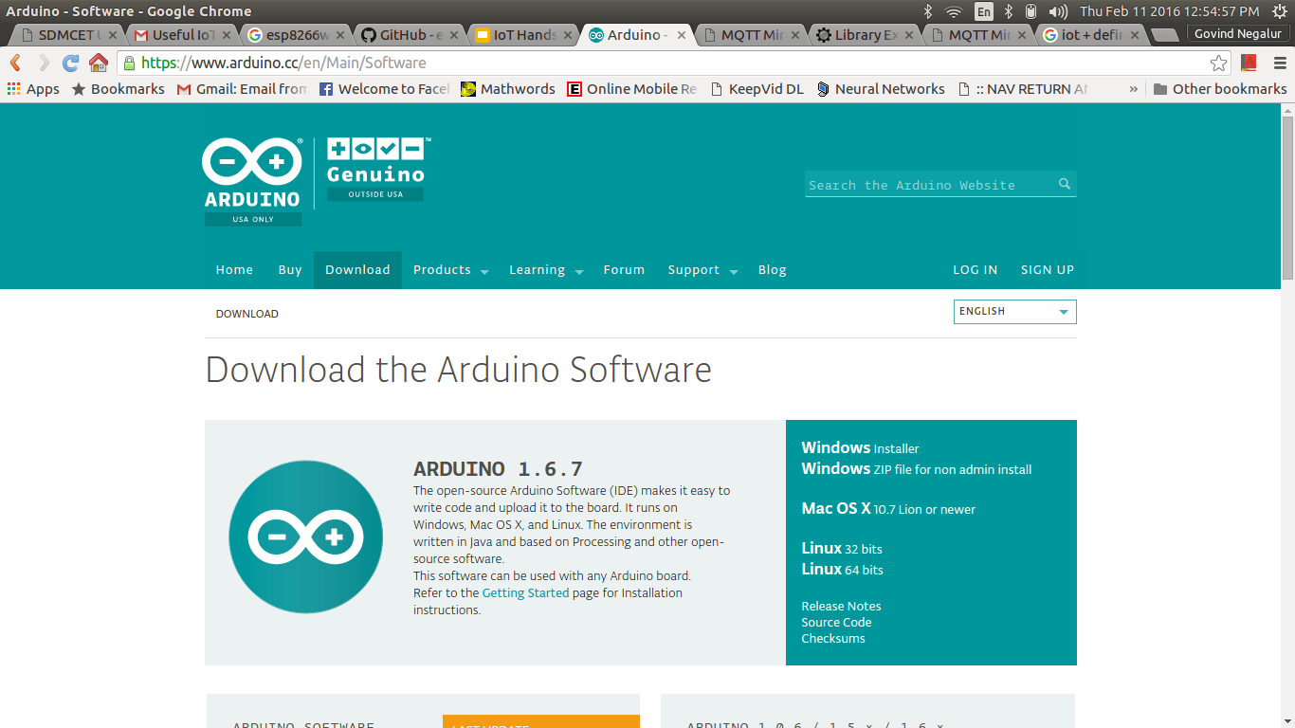
Arduino IDE - Download from https://www.arduino.cc/en/Main/Software

Slide 12
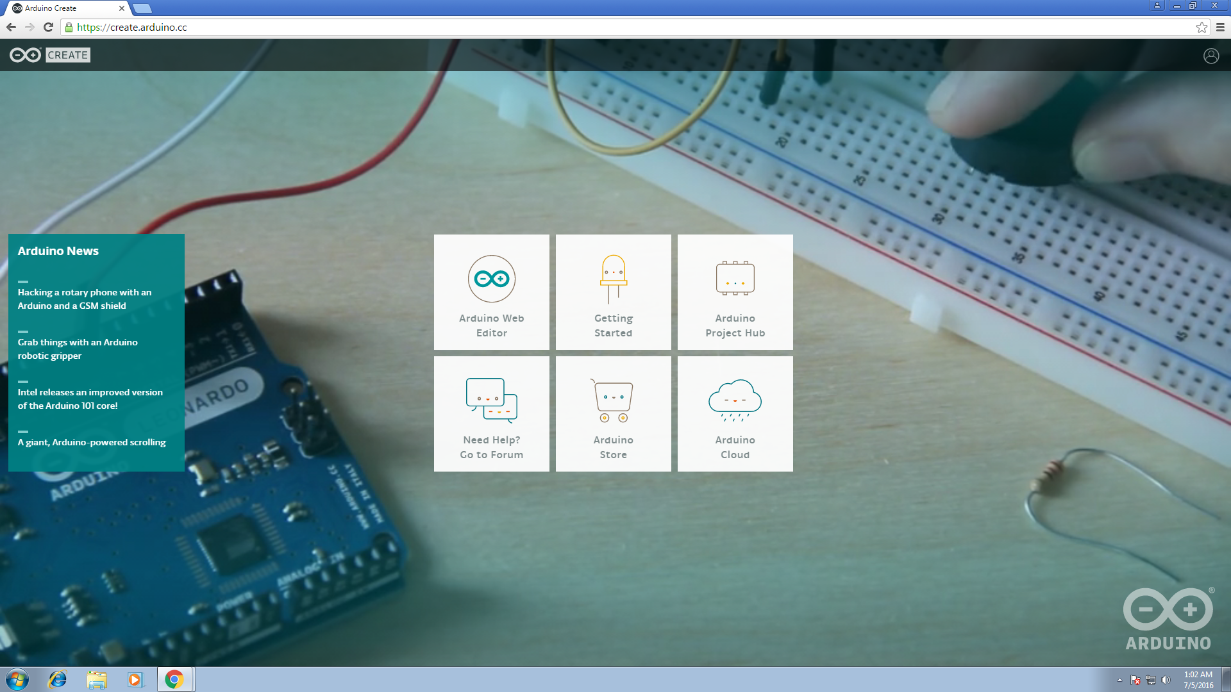
https://create.arduino.cc

Slide 13
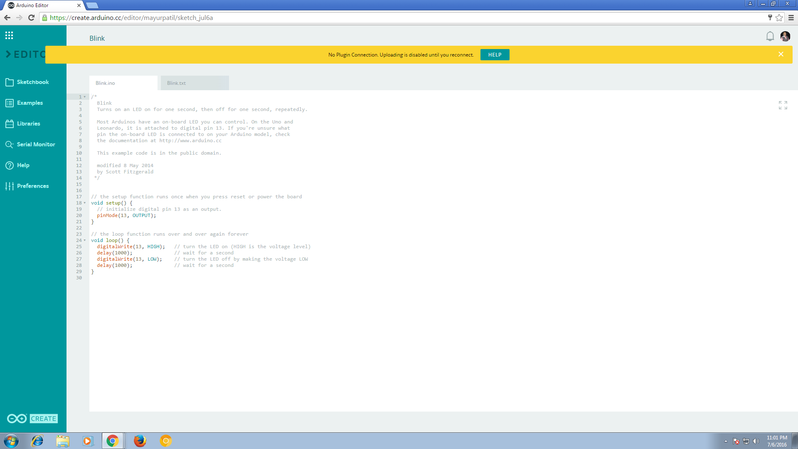
Arduino Web Editor

Slide 14
https://cloud.arduino.cc/cloud
https://github.com/arduino-libraries
https://create.arduino.cc

Slide 15
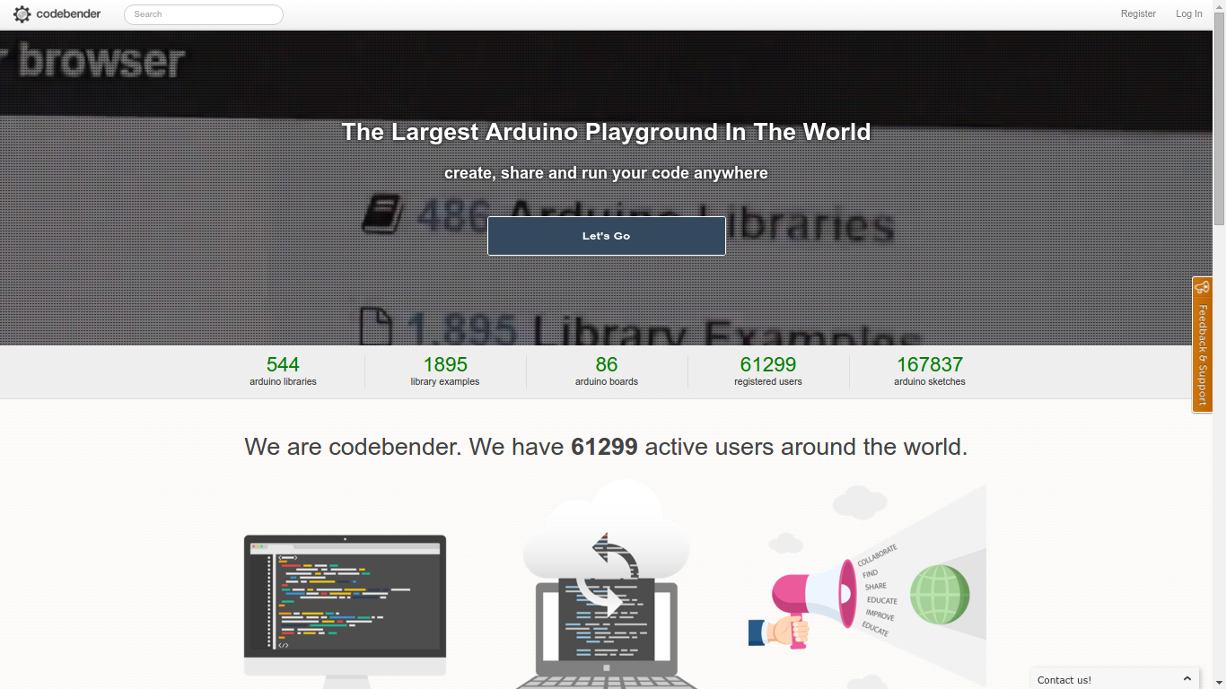
Arduino Online IDE - https://codebender.cc

Slide 16
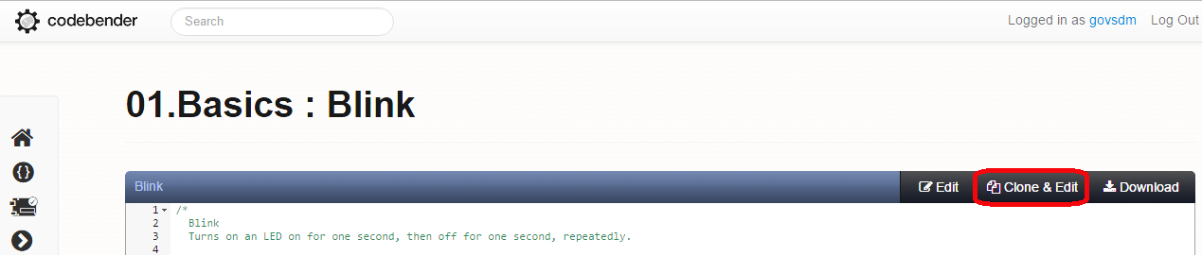
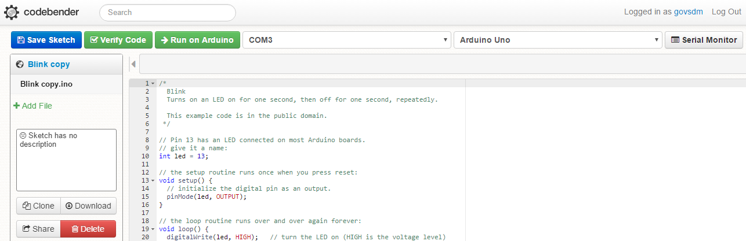

Slide 17
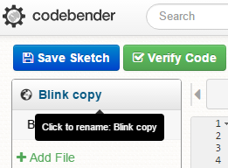
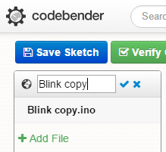
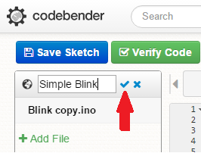
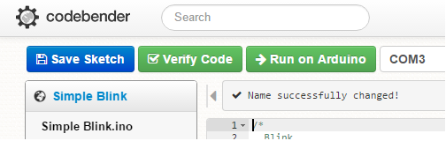
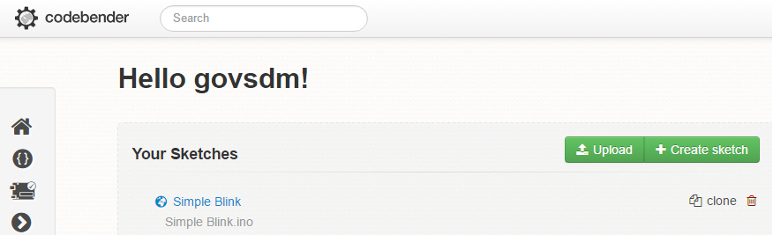
1.
2.
3.
4.
5.

Slide 18
Built-in (Pin 13) LED Blink
void setup() {
pinMode(13, OUTPUT);
}
void loop() {
digitalWrite(13, HIGH);
delay(500);
digitalWrite(13, LOW);
delay(500);
}

Slide 19
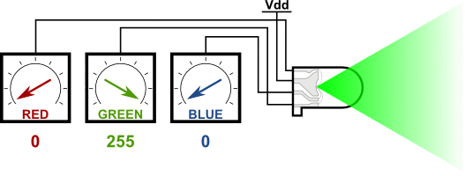
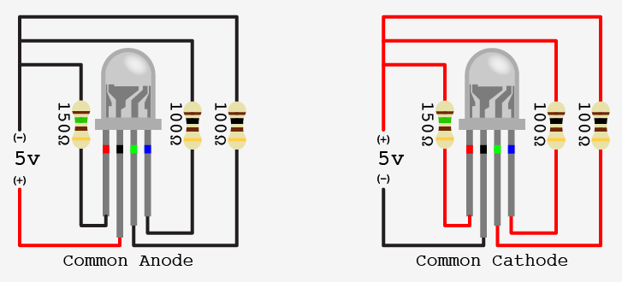
RGB - LED

Slide 20
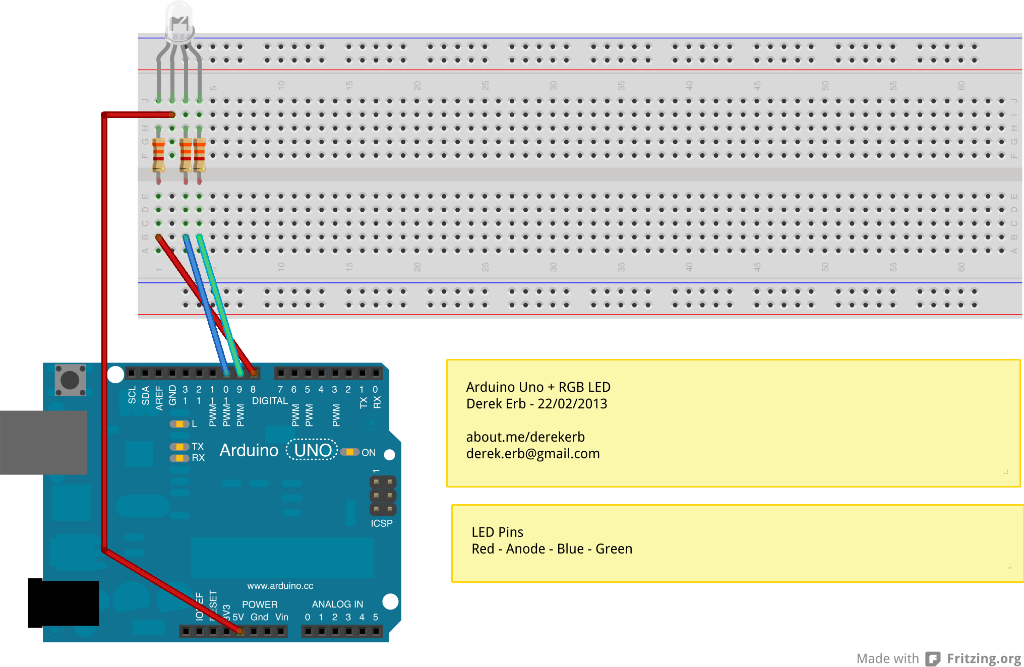
1 - RGB Connections - Safer to connect via resistors

Slide 21
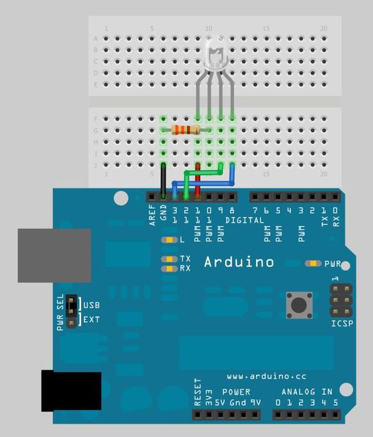
2 - RGB Connections - Safer to connect via resistors

Slide 22
Fading RGB
If you want to use it for common cathode leds you'll have to change all the "analogWrite( COLOR, 255 - colorVal );" lines to "analogWrite( COLOR, colorVal );" (without the "255 - "), then it should work (i didn't test it). http://www.instructables.com/id/Fading-RGB-LED-Arduino/?ALLSTEPS
#define GREEN 3
#define BLUE 5
#define RED 6
#define delayTime 20
void setup() {
pinMode(GREEN, OUTPUT);
pinMode(BLUE, OUTPUT);
pinMode(RED, OUTPUT);
digitalWrite(GREEN, HIGH);
digitalWrite(BLUE, HIGH);
digitalWrite(RED, HIGH);
}
int redVal;
int blueVal;
int greenVal;
void loop() {
int redVal = 255;
int blueVal = 0;
int greenVal = 0;
for( int i = 0 ; i < 255 ; i += 1 ){
greenVal += 1;
redVal -= 1;
analogWrite( GREEN, 255 - greenVal );
analogWrite( RED, 255 - redVal );
delay( delayTime );
}
redVal = 0;
blueVal = 0;
greenVal = 255;
for( int i = 0 ; i < 255 ; i += 1 ){
blueVal += 1;
greenVal -= 1;
analogWrite( BLUE, 255 - blueVal );
analogWrite( GREEN, 255 - greenVal );
delay( delayTime );
}
redVal = 0;
blueVal = 255;
greenVal = 0;
for( int i = 0 ; i < 255 ; i += 1 ){
redVal += 1;
blueVal -= 1;
analogWrite( RED, 255 - redVal );
analogWrite( BLUE, 255 - blueVal );
delay( delayTime );
}
}

Slide 23
RGB Random Colors
int ledcolor = 0; //http://www.instructables.com/id/Arduino-Examples-1-Make-An-RGB-Led-Randomly-Flash/?ALLSTEPS
int a = 1000; //this sets how long the stays one color for
int red = 11; //this sets the red led pin
int green = 12; //this sets the green led pin
int blue = 13; //this sets the blue led pin
void setup() { //this sets the output pins
pinMode(red, OUTPUT);
pinMode(green, OUTPUT);
pinMode(blue, OUTPUT);
}
void loop() {
int ledcolor = random(7); //this randomly selects a number between 0 and 6
switch (ledcolor) {
case 0: //if ledcolor equals 0 then the led will turn red
analogWrite(red, 204);
delay(a);
analogWrite(red, 0);
break;
case 1: //if ledcolor equals 1 then the led will turn green
digitalWrite(green, HIGH);
delay(a);
digitalWrite(green, LOW);
break;
case 2: //if ledcolor equals 2 then the led will turn blue
digitalWrite(blue, HIGH);
delay(a);
digitalWrite(blue, LOW);
break;
case 3: //if ledcolor equals 3 then the led will turn yellow
analogWrite(red, 160);
digitalWrite(green, HIGH);
delay(a);
analogWrite(red, 0);
digitalWrite(green, LOW);
break;
case 4: //if ledcolor equals 4 then the led will turn cyan
analogWrite(red, 168);
digitalWrite(blue, HIGH);
delay(a);
analogWrite(red, 0);
digitalWrite(blue, LOW);
break;
case 5: //if ledcolor equals 5 then the led will turn magenta
digitalWrite(green, HIGH);
digitalWrite(blue, HIGH);
delay(a);
digitalWrite(green, LOW);
digitalWrite(blue, LOW);
break;
case 6: //if ledcolor equals 6 then the led will turn white
analogWrite(red, 100);
digitalWrite(green, HIGH);
digitalWrite(blue, HIGH);
delay(a);
analogWrite(red, 0);
digitalWrite(green, LOW);
digitalWrite(blue, LOW);
break;
}
}

Slide 24
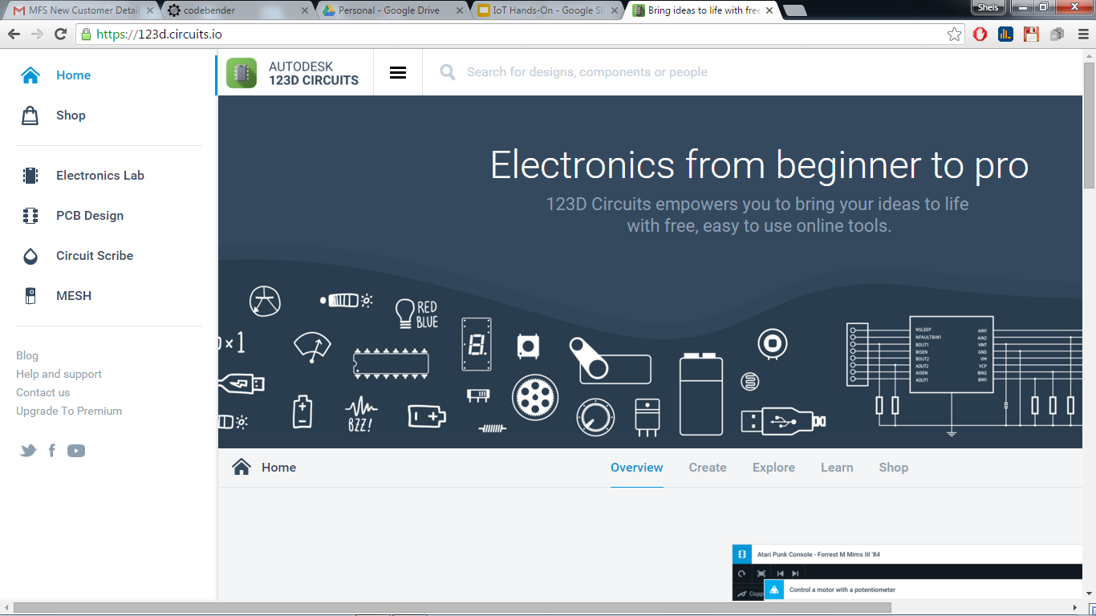
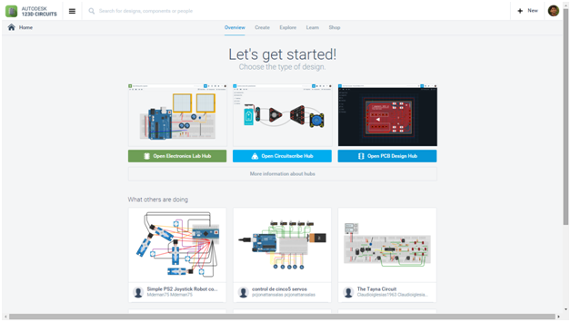
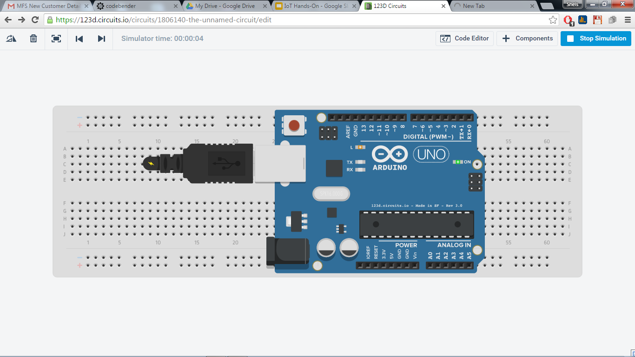
123d.circuits.io - Design, Compile, and Simulate your electronic projects Online – for Free

Slide 25
Random & Fading RGB simulation using 123d.circuits.io [Hands-on]
Random RGB:
https://123d.circuits.io/circuits/1806406-random-rgb-leds/embed#breadboard
https://123d.circuits.io/circuits/1806406-random-rgb-leds/embed#schematic
https://123d.circuits.io/circuits/1806406-random-rgb-leds/embed#pcb
Fading RGB:
https://123d.circuits.io/circuits/1806331-fading-rgb-leds/embed#breadboard
https://123d.circuits.io/circuits/1806331-fading-rgb-leds/embed#schematic
https://123d.circuits.io/circuits/1806331-fading-rgb-leds/embed#pcb

Slide 26
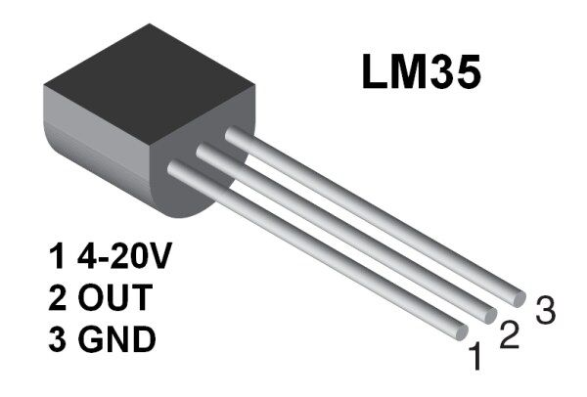
LM35 Analog Temperature Sensor

Slide 27
LM35 Features
Calibrated Directly in Celsius (Centigrade)
Linear + 10-mV/°C Scale Factor
Operates from 4 V to 30 V
Suitable for Remote Applications
Rated for Full −55°C to 150°C Range
Low Self-Heating, 0.08°C in Still Air

Slide 28

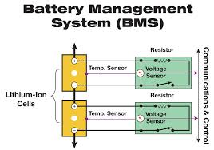

LM35 Applications
Power Supplies
Battery Management
HVAC
Temperature Sensitive Appliances

Slide 29
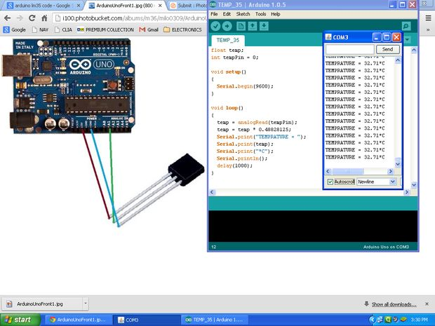
LM35 Analog Temperature Sensor Connections
Always connect LM35 on Arduino Board directly

Slide 30
const int groundpin = A0;
const int powerpin = A2;
int tempPin = A1;
float tempC;
float reading;
void setup() {
Serial.begin(9600);
pinMode(groundpin, OUTPUT);
pinMode(powerpin, OUTPUT);
digitalWrite(groundpin, LOW);
digitalWrite(powerpin, HIGH);
analogReference(INTERNAL);
}
void loop() {
reading = analogRead(tempPin);
tempC = reading / 9.31;
Serial.print("Temperature: ");
Serial.println(tempC);
delay(1000);
}

Slide 31
const int groundpin = A0;
const int powerpin = A2;
int tempPin = A1;
float tempC;
int reading;
int led=13;
int con=0;
void setup() {
Serial.begin(9600);
pinMode(groundpin, OUTPUT);
pinMode(powerpin, OUTPUT);
pinMode(led, OUTPUT);
digitalWrite(groundpin, LOW);
digitalWrite(powerpin, HIGH);
analogReference(INTERNAL);
}
void loop() {
if(Serial.available() > 0) {
con = Serial.read();
}
if(con == '1') {
digitalWrite(led, HIGH);
} else {
digitalWrite(led, LOW);
}
reading = analogRead(tempPin);
tempC = reading / 9.31;
Serial.println(tempC);
delay(1000);
}

Slide 32
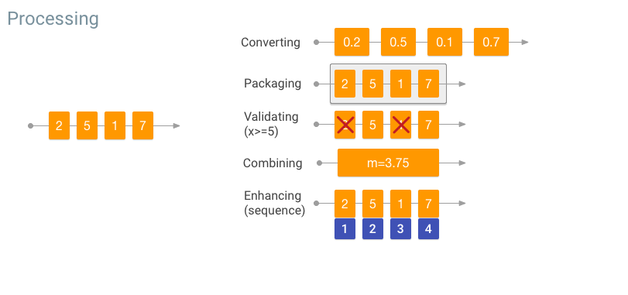
On-device processing
After data is collected from a sensor, the device can provide data processing functionality before sending the data to the cloud to enable more information to be transmitted in a smaller data footprint. Details are here
Processing includes things like:
Converting data to another format
Packaging data in a way that's secure and combines the data into a practical batch
Validating data to ensure it meets a set of rules
Sorting data to create a preferred sequence
Enhancing data to decorate the core value with additional related information
Summarizing data to reduce the volume and eliminate unneeded or unwanted detail
Combining data into aggregate values

Slide 33
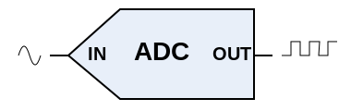
Analog-to-Digital Converter (ADC)
Analog pins might have access to an on-board Analog-to-Digital Converter (ADC) circuit.
When we read the value of a digital I/O pin in code, the value must be either HIGH or LOW, where an analog input pin at any given moment could be any value in a range.
The range depends on the resolution of ADC. For example an 8-bit ADC can produce digital values from 0 to 255, while a 10-bit ADC can yield a wider range of values, from 0 to 1023. More values manes higher resolution and thus a more faithful digital representation of any given analog signal.

Slide 34
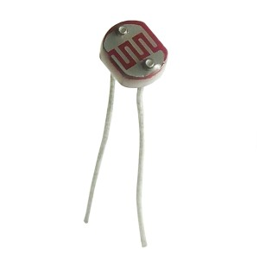
LDR - Light Dependent Resistor Sensor

Slide 35
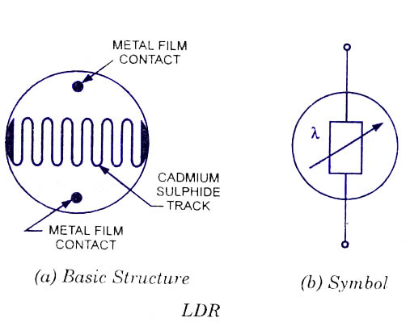
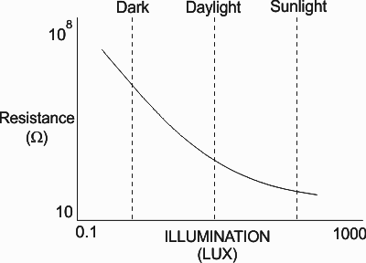
LDR Sensor - Resistance vs Light Intensity

Slide 36
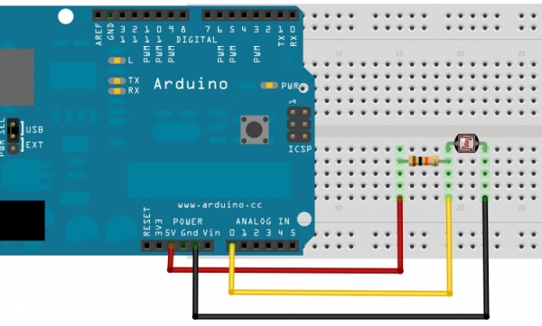
LDR Connections

Slide 37
Blink the LED if LDR crosses 500
//http://www.hobbytronics.co.uk/arduino-tutorial8-nightlight
int sensorPin = A0; // select the input pin for the ldr unsigned int sensorValue = 0; // variable to store the value coming from the ldr void setup() { pinMode(13, OUTPUT); //Start Serial port Serial.begin(9600); // start serial for output - for testing } void loop() { // read the value from the ldr: sensorValue = analogRead(sensorPin);
Serial.println(sensorValue); if(sensorValue>500) digitalWrite(13, HIGH); // set the LED on else digitalWrite(13, LOW); // set the LED on // For DEBUGGING - Print out our data, uncomment the lines below //Serial.print(sensorValue, DEC); // print the value (0 to 1024) //Serial.println(""); // print carriage return //delay(500); }

Slide 38
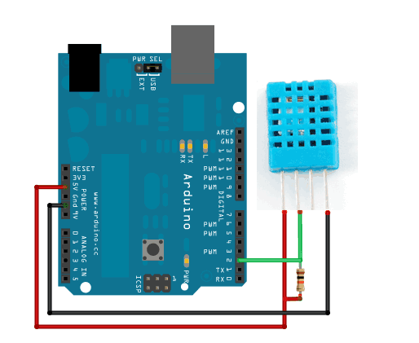
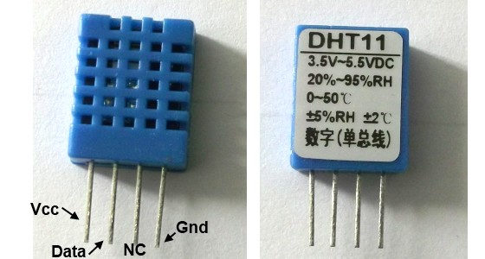
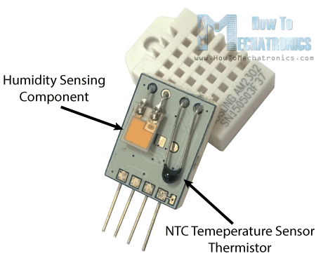
DHT11 - Digital Humidity and Temperature
Safer to connect a resistor between pin 1 and 2

Slide 39
DHT11 Features
Low cost
3 to 5V power and I/O
2.5mA max current use during conversion (while requesting data)
Good for 20-80% humidity readings with 5% accuracy
Good for 0-50°C temperature readings ±2°C accuracy
No more than 1 Hz sampling rate (once every second)
Body size 15.5mm x 12mm x 5.5mm
4 pins with 0.1" spacing

Slide 40
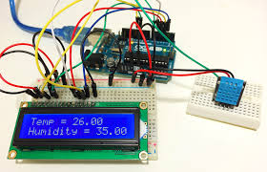
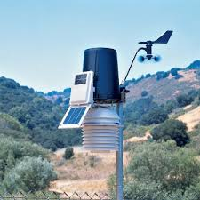
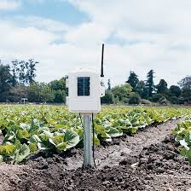
DHT11 Applications
Weather stations for providing humidity at cheaper cost
Sense temperature level of soil
Power Supplies
Battery Management
HVAC (stands for Heating, Ventilation and Air Conditioning)
Temperature Sensitive Appliances

Slide 41
#include "DHT.h"
#define DHTPIN 2 // what pin we're connected to
void setup() {
Serial.begin(9600);
Serial.println("DHTxx test!");
dht.begin();
}
void loop() {
// Wait a few seconds between measurements.
delay(2000);
// Reading temperature or humidity
//takes about 250 milliseconds!
// Sensor readings may also be up to
//2 seconds 'old' (its a very slow sensor)
float h = dht.readHumidity();
// Read temperature as Celsius
float t = dht.readTemperature();
// Read temperature as Fahrenheit
float f = dht.readTemperature(true);
// Check if any reads failed and exit early (to try again).
if (isnan(h) || isnan(t) || isnan(f)) {
Serial.println("Failed to read from DHT sensor!");
return;
}
// Compute heat index
// Must send in temp in Fahrenheit!
float hi = dht.computeHeatIndex(f, h);
Serial.print("Humidity: ");
Serial.print(h);
Serial.print(" %\t");
Serial.print("Temperature: ");
Serial.print(t);
Serial.print(" *C ");
Serial.print(f);
Serial.print(" *F\t");
Serial.print("Heat index: ");
Serial.print(hi);
Serial.println(" *F");
}

Slide 42
DHT Full Device
// Compute heat index
// Must send in temp in Fahrenheit!
float hi = dht.computeHeatIndex(f, h);
//Serial.print("Humidity: ");
//Serial.print(h);
//Serial.print(" %\t");
//Serial.print("Temperature: ");
Serial.print(t);
Serial.print("-");
Serial.print(h);
Serial.print("-");
//Serial.print(" *C ");
//Serial.print(f);
//Serial.print(" *F\t");
//Serial.print("Heat index: ");
//Serial.print(hi);
//Serial.println(" *F\t");
//Serial.println("Intensity: ");
Serial.println(intensity/200);
if(Serial.available() > 0) {
cloud_in = Serial.read();
if(cloud_in == '0') {
digitalWrite(relay_pin, LOW);
}
if(cloud_in == '1') {
digitalWrite(relay_pin, HIGH);
}
}
delay(2000);
}
#include "DHT.h"
#define DHTPIN 2 // what pin we're connected to
#define DHTTYPE DHT11 // DHT 11
DHT dht(DHTPIN, DHTTYPE);
int luxPin = A5;
int relay_pin = 13;
int cloud_in;
float tempC;
int intensity;
const int tempPin = A1;
const int groundPin = 14;
const int powerPin = 16;
void setup() {
Serial.begin(9600);
pinMode(relay_pin, OUTPUT);
dht.begin();
}
void loop() {
intensity = analogRead(luxPin);
// Reading temperature or humidity takes about 250 milliseconds!
// Sensor readings may also be up to 2 seconds 'old' (its a very slow sensor)
float h = dht.readHumidity();
// Read temperature as Celsius
float t = dht.readTemperature();
// Read temperature as Fahrenheit
float f = dht.readTemperature(true);
// Check if any reads failed and exit early (to try again).
if (isnan(h) || isnan(t) || isnan(f)) {
Serial.println("Failed to read from DHT sensor!");
return;
}

Slide 43
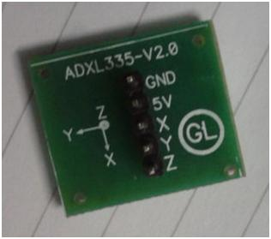
ADXL335 Accelerometer

Slide 44
ADXL335 Features
3-axis sensing
Small, low-profile package
Low power - 350 μA (typical)
Single-supply operation
1.8 V to 3.6 V
10,000 g shock survival
Excellent temperature stability
BW adjustment with a single capacitor per axis
RoHS Restriction of Hazardous Substances /WEEE Waste Electrical and Electronic Equipment Directive lead-free compliant

Slide 45
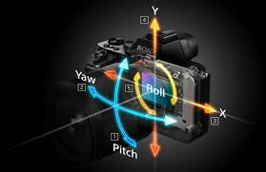


ADXL335 Applications
Cost sensitive, low power, motion and tilt-sensing applications
Mobile devices
Gaming systems
Disk drive protection
Image stabilization
Sports and health devices

Slide 46
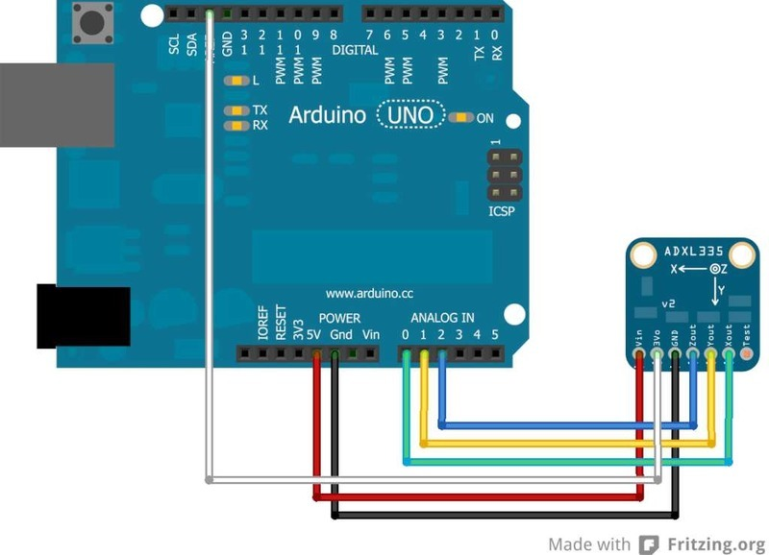
Connections

Slide 47
Code is built-in Arduino IDE’s Examples

Slide 48
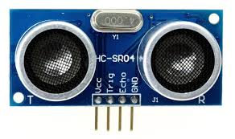
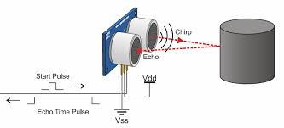
HC - SR04 Ultrasonic Range Sensor

Slide 49
HC - SR04 Ultrasonic Range Sensor - Details
Product features: Ultrasonic ranging module HC - SR04 provides 2cm - 400cm non-contact measurement function, the ranging accuracy can reach to 2mm.
The module includes ultrasonic transmitter, receiver and control circuit. The basic principle of working is:
(1) IO trigger for at-least 10μs high level signal
(2) The Module automatically sends eight 40 kHz and detects whether there is a pulse signal back
(3) If the signal is back, through high level, then the time of high output IO duration is the time from sending ultrasonic to returning
Test distance = (high level time×velocity of sound (340ms⁻¹) / 2

Slide 50
/* HC-SR04 Sensor
https://www.dealextreme.com/p/hc-sr04-ultrasonic-sensor-distance-measuring-module-133696
This sketch reads a HC-SR04 ultrasonic rangefinder and returns the distance to the closest object in range. To do this, it sends a pulse to the sensor to initiate a reading, then listens for a pulse to return. The length of the returning pulse is proportional to the distance of the object from the sensor.
The circuit:
* VCC connection of the sensor attached to +5V
* GND connection of the sensor attached to ground
* TRIG connection of the sensor attached to digital pin 2
* ECHO connection of the sensor attached to digital pin 4
Original code for Ping))) example was created by David A. Mellis
Adapted for HC-SR04 by Tautvidas Sipavicius
This example code is in the public domain.*/
const int trigPin = 2;
const int echoPin = 4;
void setup() {
// initialize serial communication:
Serial.begin(9600);
}
void loop() {
// establish variables for duration of the ping,
// and the distance result in inches and centimeters:
long duration, inches, cm;
// The sensor is triggered by a HIGH pulse of 10 or more microseconds.
// Give a short LOW pulse beforehand to ensure a clean HIGH pulse:
pinMode(trigPin, OUTPUT);
digitalWrite(trigPin, LOW);
delayMicroseconds(2);
digitalWrite(trigPin, HIGH);
delayMicroseconds(10);
digitalWrite(trigPin, LOW);
// Read the signal from the sensor: a HIGH pulse whose duration is the time (in microseconds) from the sending of the ping to the reception of its echo off of an object.
pinMode(echoPin, INPUT);
duration = pulseIn(echoPin, HIGH);
// convert the time into a distance
inches = microsecondsToInches(duration);
cm = microsecondsToCentimeters(duration);
Serial.print(inches);
Serial.print("in, ");
Serial.print(cm);
Serial.print("cm");
Serial.println();
delay(100);
}

Slide 51
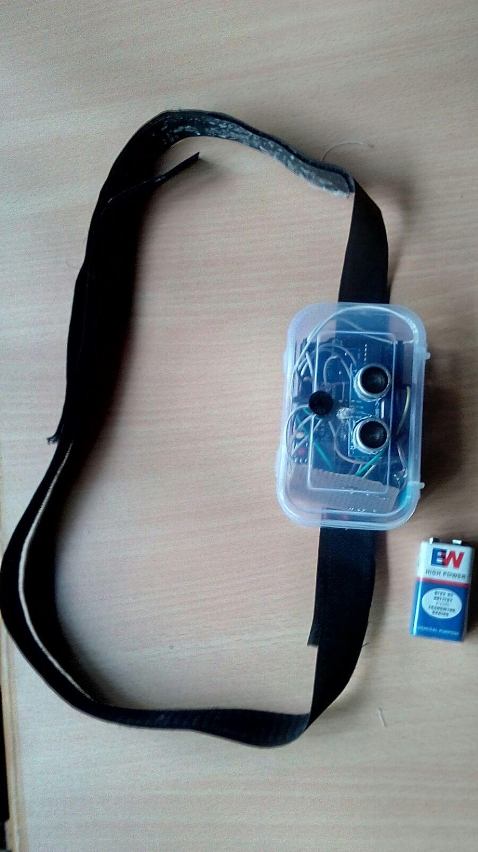
cntd - Details here
long microsecondsToInches(long microseconds)
{
// According to Parallax's datasheet for the PING))), there are
// 73.746 microseconds per inch (i.e. sound travels at 1130 feet per
// second). This gives the distance travelled by the ping, outbound
// and return, so we divide by 2 to get the distance of the obstacle.
// See: http://www.parallax.com/dl/docs/prod/acc/28015-PING-v1.3.pdf
return microseconds / 74 / 2;
}
long microsecondsToCentimeters(long microseconds)
{
// The speed of sound is 340 m/s or 29 microseconds per centimeter.
// The ping travels out and back, so to find the distance of the
// object we take half of the distance travelled.
return microseconds / 29 / 2;
}

Slide 52
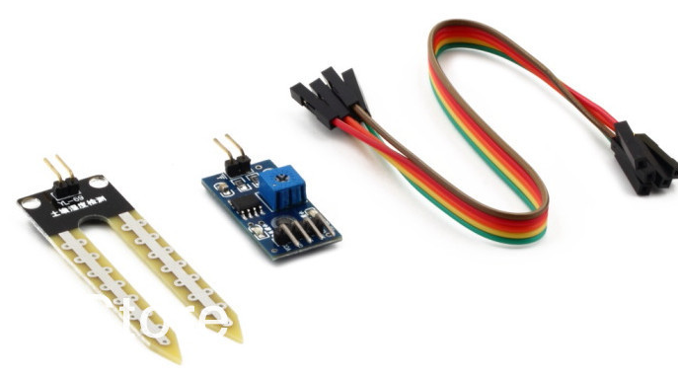
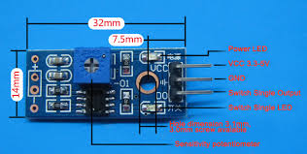
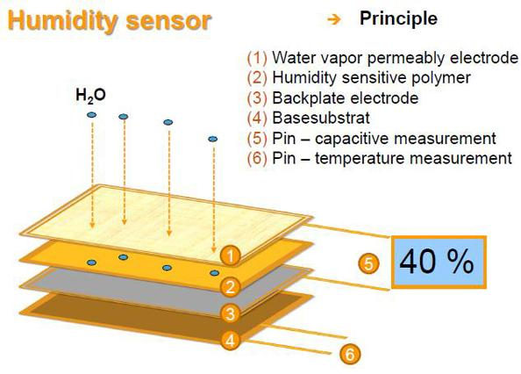
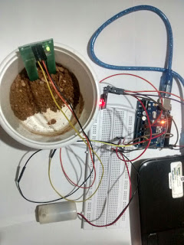
If the soil is homogeneous & receives similar watering over an area then a single probe will give a representative reading for that area. If regions of soil are different in composition, for example sandy or loamy, then you may want to use a probe for each type of soil region, and for areas that receive different watering. Src

Slide 53
Soil Moisture Sensor YL-69
void loop()
{
int s = analogRead(A0); //take a sample
Serial.print(s);
Serial.print(" - ");
if(s >= 1000) {
Serial.println("Sensor is not in the Soil or DISCONNECTED");
}
if(s < 1000 && s >= 600) {
Serial.println("Soil is DRY");
}
if(s < 600 && s >= 370) {
Serial.println("Soil is HUMID");
}
if(s < 370) {
Serial.println("Sensor in WATER");
}
delay(1000);
}
/* Connection pins:
Arduino Soil Moisture Sensor YL-69
A0 Analog A0
5V VCC
GND GND
*/
void setup()
{
Serial.begin(9600);
pinMode(A0, INPUT); //set up analog pin 0 to be input
// pinMode(2, OUTPUT); // red led
// pinMode(3, OUTPUT); // yellow led
//pinMode(4, OUTPUT); // green led
}

Slide 54


Controlling DC Motor from Arduino using LM293D
This module is a medium powered motor driver perfect for driving DC motors and Stepper motors.
It uses the popular Motor Driver Board H-bridge motor driver IC.
It can drive 4 DC motors in one direction, or drive 2 DC motors in both the directions with speed control.
The driver greatly simplifies and increases the ease with which you may control motors, relays, etc from microcontrollers.
It can drive motors up to 12 V with a total DC current of up to 600mA.
Specifications:
Operating Voltage: 7 V to 12V DC.
4 channel output (can drive 2 DC motors bidirectionally).
600mA output current capability per channel.
PTR connectors for easy connections.
http://www.instructables.com/id/Simple-2-way-motor-control-for-the-arduino/?ALLSTEPS

Slide 55
//2-Way motor control
int motorPin1 = 9; // One motor wire connected to digital pin 9
int motorPin2 = 10; // One motor wire connected to digital pin 10
// The setup() method runs once, when the sketch starts
void setup() {
// initialize the digital pins as an output:
pinMode(motorPin1, OUTPUT);
pinMode(motorPin2, OUTPUT);
}
// the loop() method runs over and over again,as long as the Arduino has power
void loop()
{
rotateLeft(150, 500);
rotateRight(50, 1000);
rotateRight(150, 1000);
rotateRight(200, 1000);
rotateLeft(255, 500);
rotateRight(10, 1500);
}
void rotateLeft(int speedOfRotate, int length){
analogWrite(motorPin1, speedOfRotate); //rotates motor
digitalWrite(motorPin2, LOW); // set the Pin motorPin2 LOW
delay(length); //waits
digitalWrite(motorPin1, LOW); // set the Pin motorPin1 LOW
}
void rotateRight(int speedOfRotate, int length){
analogWrite(motorPin2, speedOfRotate); //rotates motor
digitalWrite(motorPin1, LOW); // set the Pin motorPin1 LOW
delay(length); //waits
digitalWrite(motorPin2, LOW); // set the Pin motorPin2 LOW
}

Slide 56



PIR Sensor
Source
Source
Source

Slide 57
/* http://www.arduinoeletronica.com.br */ Codebender Link
int PIR = 2;
int led = 13;
void setup(){
Serial.begin(9600);
pinMode(PIR, INPUT);
pinMode(led,OUTPUT);
}
void loop(){
int lerPIR = digitalRead(PIR);
if(lerPIR == LOW){ //was motion detected
digitalWrite(led,HIGH);
Serial.println("Motion Detected!");
// delay(2000);
}
else{
digitalWrite(led,LOW);
Serial.println("No Motion!");
}
}

Slide 58

HC05 Bluetooth Module

Slide 59
HC05 Bluetooth Features
2.45GHz Frequency
Asynchronous Speed 2.1Mbps (max) 160 Kbps
Security: Authentication
Profile: Bluetooth Serial Port
Power Supply: +3.3 VDc
Working Temperature: >20C
Cost : Around INR 300

Slide 60

HC05 Bluetooth Module

Slide 61
Setting up Name and Password with AT Commands
VCC Pin ➝ 5V
GND Pin ➝ GND
RX Pin ➝ RX
TX Pin ➝ TX
Key Pin/State Pin ➝ 5V
Baud Rate: 9600
Press RESET BUTTON of your Bluetooth [if available]
In Serial Monitor, type:
Type “AT”, Check for response “OK”
AT+NAME=”name_of_your_interest”
AT+PSWD=”4_digit_password”
Password must be 4-digit

Slide 62

ArduDroid - Reading Input using Bluetooth from Android

Slide 63
int ledPin = 13;
int state = 0;
//int flag = 0;
void setup() {
pinMode(ledPin, OUTPUT);
digitalWrite(ledPin, LOW);
Serial.begin(9600); // Default connection
//rate for my BT module
}
void loop() {
if(Serial.available() > 0){
state = Serial.read();
//flag=0;
}
if (state == '0') {
digitalWrite(ledPin, LOW);
// if(flag == 0) {
Serial.println("LED: off");
//flag = 1;
}
else if (state == '1') {
digitalWrite(ledPin, HIGH);
//if(flag == 0){
Serial.println("LED: on");
//flag = 1;
}
}
Code for controlling built-in LED using Bluetooth Module

Slide 65

ESP8266 Wifi Serial Module

Slide 66

Always connect VCC, CH_PD to 3.3V only

Slide 67


Slide 68
ESP8266 Wifi Serial Module
802.11 b/g/n protocol
Wi-Fi Direct (P2P), Soft-AP- SoftAP is an abbreviated term for "software enabled access point." This is software enabling a computer which hasn't been specifically made to be a router into a wireless access point. It is often used interchangeably with the term "virtual router".
Integrated TCP/IP Protocol Stack
Integrated TR switch, balun, LNA, power amplifier and matching network
Integrated PLL, regulators &power management units

Slide 69
ESP8266 Wifi Serial Module
Integrated temperature sensor
Supports antenna diversity
Power down leakage current of < 10uA
Integrated low power 32-bit CPU could be used as application processor
SDIO 2.0, SPI, UART
STBC, 1×1 MIMO, 2×1 MIMO
A-MPDU & A-MSDU aggregation & 0.4s guard interval
Wake up and transmit packets in < 2ms
Standby power consumption of < 1.0mW (DTIM 3)

Slide 70

https://thingspeak.com

Slide 71
ThingSpeak API
#include<stdlib.h>
const int groundpin = A0;
const int powerpin = A2;
const int receiver = 0;
float tempC;
int reading;
int tempPin = A1;
int led=13; int con=0;
String apiKey = "27RPRHYGBJ335YGE";
void setup() {
Serial.begin(115200);
pinMode(groundpin, OUTPUT);
pinMode(powerpin, OUTPUT);
pinMode(led, OUTPUT);
digitalWrite(groundpin, LOW);
digitalWrite(powerpin, HIGH);
analogReference(INTERNAL);
// reset ESP8266
Serial.println("AT+RST");
Serial.println("AT+CIPMUX=0");
}
void loop() {
reading = analogRead(tempPin);
tempC = reading / 9.31;
// convert to string
char buf[16];
String strTemp = dtostrf(tempC, 5, 2, buf);
Serial.println(tempC);
// TCP connection
String cmd = "AT+CIPSTART=\"TCP\",\"";
cmd += "api.thingspeak.com"; // api.thingspeak.com
cmd += "\",80";
Serial.println(cmd);
if(Serial.find("Error")){
Serial.println("AT+CIPSTART error");
return;
}
// prepare GET string
String getStr = "GET /update?key=";
getStr += apiKey;
getStr +="&field1=";
getStr += String(strTemp);
getStr += "\r\n\r\n";
// send data length
cmd = "AT+CIPSEND=";
cmd += String(getStr.length());
Serial.println(cmd);
if(Serial.find(">")){
Serial.print(getStr);
}
else{
// alert user
Serial.println("AT+CIPCLOSE");
}
// thingspeak needs 15 sec delay between updates
delay(5000);
}
Details

Slide 72


Slide 73
ThingSpeak Community Library For Arduino
http://www.instructables.com/id/Send-sensor-data-DHT11-BMP180-to-ThingSpeak-with-a/?ALLSTEPS

Slide 74



NodeMCU - An open-source firmware and development kit that helps you to prototype your IoT product within a few Lua script lines
src

Slide 75

In NodeMCU use GPIO numbers in Arduino Code...Connect long pin of LED to 5V TTL

Slide 76
Simple LED Blink using NodeMCU
void setup() {
// initialize digital pin 2 as an output.
pinMode(2, OUTPUT);
}
// the loop function runs over and over again forever
void loop() {
digitalWrite(2, HIGH); // turn the LED on (HIGH is the voltage level)
delay(1000); // wait for a second
digitalWrite(2, LOW); // turn the LED off by making the voltage LOW
delay(1000); // wait for a second
}
Try Connecting External LED

Slide 77
NodeMCU + ThingSpeak
/* * This sketch sends data via HTTP GET requests to data.sparkfun.com service. * * You need to get streamId and privateKey at data.sparkfun.com and paste them * below. Or just customize this script to talk to other HTTP servers.* */
#include <ESP8266WiFi.h>
const char* ssid = "das";
const char* password = "TCSTCSTCS";
const char* host = "api.thingspeak.com";
//const char* streamId = "....................";
const char* privateKey = "FERH0WIO017KTZ3F";
void setup() {
Serial.begin(115200);
delay(10);
// We start by connecting to a WiFi network
Serial.println();
Serial.println();
Serial.print("Connecting to ");
Serial.println(ssid);
WiFi.begin(ssid, password);
while (WiFi.status() != WL_CONNECTED) {
delay(500);
Serial.print(".");
}
Serial.println("");
Serial.println("WiFi connected");
Serial.println("IP address: ");
Serial.println(WiFi.localIP());
}
int value = 20;
void loop() {
delay(5000);
++value;
Serial.print("connecting to ");
Serial.println(host);
// Use WiFiClient class to create TCP connections
WiFiClient client;
const int httpPort = 80;
if (!client.connect(host, httpPort)) {
Serial.println("connection failed");
return;
}
// We now create a URI for the request
String url = "/update?key=";
url += privateKey;
url += "&field1=";
url += value;
Serial.print("Requesting URL: ");
Serial.println(url);

Slide 78
cntd...
// This will send the request to the server
client.print(String("GET ") + url + " HTTP/1.1\r\n" +
"Host: " + host + "\r\n" +
"Connection: close\r\n\r\n");
unsigned long timeout = millis();
while (client.available() == 0) {
if (millis() - timeout > 5000) {
Serial.println(">>> Client Timeout !");
client.stop();
return;
}
}
// Read all the lines of the reply from server and print them to Serial
while(client.available()){
String line = client.readStringUntil('\r');
Serial.print(line);
}
Serial.println();
Serial.println("closing connection");
}

Slide 79

Output in ThingSpeak

Slide 80

Explore Embedded - The module goes into programming mode with a single reset switch.
Fits on a breadboard!
Single button 'Reset' switch for programming. Uses MOSFET's to put the module in programming mode.
All pins of ESP12E taken out
Separate serial pins breakout compatible with FTDI cable layout.
On-board LM1117-3.3V regulator
Works with Arduino IDE for ESP8266
ESP8266 ESP12E features
802.11 b/g/n protocol
Wi-Fi Direct (P2P), soft-AP
Integrated TCP/IP protocol stack
Integrated TR switch, balun, LNA, power amplifier and matching network
Integrated PLL, regulators, and power management units
+19.5dBm output power in 802.11b mode
Integrated temperature sensor
Supports antenna diversity
Power down leakage current of < 10uA
Integrated low power 32-bit CPU could be used as application processor
SDIO 2.0, SPI, UART
STBC, 1Ã—1 MIMO, 2Ã—1 MIMO
A-MPDU & A-MSDU aggregation & 0.4ï­s guard interval
Wake up and transmit packets in < 2ms
Standby power consumption of < 1.0mW (DTIM3)
Resources

Slide 81


Explore Embedded - Connect with CP2102
Hard press RESET switch to reprogram the module

Slide 82

Same code as NodeMCU

Slide 83

Output in Serial Monitor

Slide 84
IoT Protocols

Slide 85

MQTT (formerly MQ Telemetry Transport) is an ISO standard (ISO/IEC PRF 20922) publish-subscribe based "light weight" messaging protocol for use on top of the TCP/IP protocol. It is designed for connections with remote locations where a "small code footprint" is required or the network bandwidth is limited. It is ideal for mobile applications because of its small size, low power usage, minimised data packets, and efficient distribution of information to one or many receivers.

Slide 86

Public MQTT Brokers
http://moxd.io/2015/10/public-mqtt-brokers/

Slide 87

https://chrome.google.com/webstore/detail/mqttlens/hemojaaeigabkbcookmlgmdigohjobjm?hl=en

Slide 88
Controlling Relay Switch using MQTT from Cloud/App
void loop() {
if (!client.connected()) mqtt_reconnect();
client.loop();
client.publish("sdmcetcse/light1", "SDMCET Dwd");
delay(5000);
}
// for MQTT callback
void callback(char* topic, byte* payload, unsigned int length) {
// get topic as a string
String strTopic = String(topic);
// get payload as a string
char charPayload[length];
for (int i = 0; i < length; i++) charPayload[i] = (char)payload[i];
String strPayload = (String(charPayload)).substring(0, length);
Serial.println(strPayload);
if (topic_1.equals(strTopic)) {
if (strPayload.equals("off")) {
client.publish("sdmcetcse/light1", "Light-1 OFF");
light_off(builtin_led);
} else if (strPayload.equals("on")) {
client.publish("sdmcetcse/light1", "Light-1 ON");
light_on(builtin_led);
}
}
#include <ESP8266WiFi.h>
#include <PubSubClient.h>
// setup WiFi & MQTT details
const char* ssid = "GovindAP";
const char* pass = "*************";
const char* mqtt_server = "test.mosquitto.org”;
int status = WL_IDLE_STATUS;
String topic_1 = "sdmcetcse/light1";
int builtin_led = 2;
WiFiClient wifiClient;
PubSubClient client(wifiClient);
void setup() {
// setup serial
Serial.begin(115200);
// setup & initialize gpio
pinMode (builtin_led, OUTPUT);
digitalWrite(builtin_led, HIGH);
// setup wifi
setup_wifi();
// setup mqtt
client.setServer(mqtt_server, 1883);
client.setCallback(callback);
}
Link to PubSubClient Library
Code Credits: NBN RIOT Workshop, Pune

Slide 89
else {
client.publish("NJMZuDbYxt_err", "mistake in topic error");
}
}
void light_on (int light) {
digitalWrite(light, LOW);
}
void light_off (int light) {
digitalWrite(light, HIGH);
}
void setup_wifi() {
delay(10);
WiFi.begin(ssid, pass);
while (WiFi.status() != WL_CONNECTED) {
delay(500);
}
}
void mqtt_reconnect() {
while (!client.connected()) {
if (client.connect("Sw_Cub1_ESPClient")) {
client.subscribe("sdmcetcse/#");
client.publish("sdmcetcse/light1", "Connected");
delay(100);
} else {
delay(5000);
}
}
}

Slide 90


https://play.google.com/store/apps/details?id=at.tripwire.mqtt.client&hl=en

Slide 91
Web Controlled LED
https://github.com/mayurpatil/WebControlledLED
99.xd09spz04.appspot.com

Slide 92
Installing Additional Boards on Arduino [Offline]
Offline Arduino IDE is required for writing code directly on ESP8266
Goto “File” ⇒ “Preferences”, paste in “Additional Boards Manager URL”: http://arduino.esp8266.com/stable/package_esp8266com_index.json
Go-to “Tools” ⇒ “Board” ⇒ “Boards Manager”
Search for ESP8266 and select the version (2.1.0 current version) and click on “Install” button
Once installed, select “Generic ESP8266 Module” from “Tools” ⇒ “Board”

Slide 93
Uploading code directly to ESP8266
Connect GPIO0 pin to GND
Connect GPIO2 pin to 3.3V and disconnect
Connect RESET pin to GND ⇒ 3.3V ⇒ GND and disconnect

Slide 94
Built-in LED Blink using ESP8266
/* ESP8266 Blink by Simon Peter Blink the blue LED on the ESP-01 module This example code is in the public domain The blue LED on the ESP-01 module is connected to GPIO1 (which is also the TXD pin; so we cannot use Serial.print() at the same time) Note that this sketch uses LED_BUILTIN to find the pin with the internal LED */
void setup() {
pinMode(LED_BUILTIN, OUTPUT); // Initialize the LED_BUILTIN pin as an output
}
// the loop function runs over and over again forever
void loop() {
digitalWrite(LED_BUILTIN, LOW); // Turn the LED on (Note that LOW is the voltage level
// but actually the LED is on; this is because
// it is acive low on the ESP-01)
delay(1000); // Wait for a second
digitalWrite(LED_BUILTIN, HIGH); // Turn the LED off by making the voltage HIGH
delay(2000); // Wait for two seconds (to demonstrate the active low LED)
}

Slide 95

Updating ESP8266 Firmware
Click here for STEPS

Slide 96
NodeMCU Code on ESP8266
Code same as NodeMCU except below change:
int builtin_led = 2; ⇒ use LED_BUILTIN option available in ESP8266WiFi.h

Slide 97

GSM Module for Arduino
Features:
Send/Receive SMS
Make/Receive Calls
Place to insert SIM
On-board 3.5 mm jack to connect a headphone to answer calls
Uses AT commands to configure and communicate with the shield

Slide 98





Applications of GSM Module
Image Credits 1 2 3 4 5
Home Automation
Vehicle Tracking
Remote Monitoring and Control
Agricultural Automation
Industrial Automation
GPRS Data Logging

Slide 99
Sending SMS via GSM Module
#include <GSM.h>
#define PINNUMBER ""
// initialize the library instance
GSM gsmAccess;
GSM_SMS sms;
void setup() {
// initialize serial communications and wait for port to open:
Serial.begin(9600);
while (!Serial) ; // wait for serial port to connect (Leonardo only)
Serial.println("SMS Messages Sender");
// connection state
boolean notConnected = true;
// Start GSM shield
// If your SIM has PIN, pass it as a parameter of begin() in quotes
while(notConnected) {
if(gsmAccess.begin(PINNUMBER)==GSM_READY)
notConnected = false;
else {
Serial.println("Not connected");
delay(1000);
}
}
Serial.println("GSM initialized");
}
void loop() {
Serial.print("Enter a mobile number: ");
char remoteNum[20]; // telephone number to send sms
readSerial(remoteNum);
Serial.println(remoteNum);
Serial.print("Now, enter SMS content: ");
char txtMsg[200];
readSerial(txtMsg);
Serial.println("SENDING");
Serial.println();
Serial.println("Message:");
Serial.println(txtMsg);
sms.beginSMS(remoteNum);
sms.print(txtMsg);
sms.endSMS();
Serial.println("\nCOMPLETE!\n");
}
/*Read input serial*/
int readSerial(char result[]) {
int i = 0;
while(1) {
while (Serial.available() > 0) {
char inChar = Serial.read();
if (inChar == '\n') {
result[i] = '\0';
Serial.flush();
return 0;
}
if(inChar!='\r')
{
result[i] = inChar;
i++;
}
}
}
}

Slide 100

Arduino Ethernet Shield

Slide 101
Ethernet Shield Features
Based on W51000 chip
It has internal 16K buffer
Connection speed upto 10/100Mb
Comes bundled with Arduino Ethernet Library
Contains on-board micro SD slot (requires use of external SD card library)

Slide 102
Display DHCP IP Address
#include <SPI.h>
#include <Ethernet.h>
byte mac[] = { 0x00, 0xAA, 0xBB, 0xCC, 0xDE, 0x02 };
EthernetClient client;
void setup() {
Serial.begin(9600);
// start the Ethernet connection:
if (Ethernet.begin(mac) == 0) {
Serial.println("Failed to configure Ethernet using DHCP");
// no point in carrying on, so do nothing forevermore:
for (;;) ;
}
Serial.print("My IP address: ");
for (byte thisByte = 0; thisByte < 4; thisByte++) {
Serial.print(Ethernet.localIP()[thisByte], DEC);
}
Serial.println();
}
void loop() {
}

Slide 103

Codenvy.com + Google App Engine Code
The program is developed using codenvy.com IDE and HTML/Java Servlets. This program sends temperature value from LM35 to Google App Engine using ESP8266
http://9.xd09spz04.appspot.com

Slide 104
index.html
<!DOCTYPE html>
<html>
<head>
<title>Temp Sensors Demo</title>
</head>
<center>
<h3>
LM35 Analog Temperature values being stored on Google Datastore.
</h3>
<body>
<form action="/TempSense" method="GET">
<input type="Submit" value="Refresh" name="btn">
</form>
</body>
</center>
</html>

Slide 105
package arduino;
import javax.servlet.ServletException;
import javax.servlet.http.HttpServlet;
import javax.servlet.http.HttpServletRequest;
import javax.servlet.http.HttpServletResponse;
import java.io.IOException;
import com.google.appengine.api.datastore.*;
public class TempSenseServelt extends HttpServlet {
public void doGet(HttpServletRequest req, HttpServletResponse resp) throws IOException, ServletException {
resp.setContentType("text/html");
String temp = req.getParameter("temperature");
DatastoreService datastore = DatastoreServiceFactory.getDatastoreService();
if (temp == null)
temp = "999";
Key dbKey = KeyFactory.createKey("Sensor_DB", temp);
Entity tempObj = new Entity("Sensor_DB", dbKey);
tempObj.setProperty("temperature", temp);
datastore.put(tempObj);
//if (btn.equals("Refresh"))
Query q = new Query("Sensor_DB") ;
PreparedQuery pq = datastore.prepare(q);
resp.getWriter().println("<center><table>");
resp.getWriter().println("<th>Temp</th>");
for (Entity result : pq.asIterable()) {
temp = result.getProperty("temperature").toString();
resp.getWriter().println("<tr><H1>");
resp.getWriter().println("<td>" + temp + "</td></td>");
resp.getWriter().println("</H1></tr>");
}
resp.getWriter().println("</table></center>");
}
}

Slide 106
Arduino code to turn on/off pin-13 LED from local - Telnet & Browser - 192.168.4.1/?pin=1
[Ensure you have connected your mobile/laptop to the WiFi Module]
#include<stdlib.h>
int led=13;
void setup() {
Serial.begin(115200);
pinMode(led, OUTPUT);
Serial.println("AT+CIPMUX=1"); /* this is required */
delay(500); /* delay is required */
Serial.println("AT+CIPSERVER=1,1336");
/* incase of connection refused, press RESET button */
}
void loop() {
if(Serial.available()) {
delay(500);
if(Serial.find("+IPD,")) {
delay(500);
Serial.find("pin=");
int status = Serial.read()-48;
if(status == 1) {
digitalWrite(led, HIGH);
Serial.println("LED is ON");
} else {
digitalWrite(led, LOW);
Serial.println("LED is OFF");
}
}
}
}

Slide 107
9.xd09spz04.appspot.com
#include<stdlib.h>
const int groundpin = A0;
const int powerpin = A2;
const int receiver = 0;
float tempC;
int reading;
int tempPin = A1;
int led=13; int con=0;
void setup() {
Serial.begin(115200);
pinMode(groundpin, OUTPUT);
pinMode(powerpin, OUTPUT);
pinMode(led, OUTPUT);
digitalWrite(groundpin, LOW);
digitalWrite(powerpin, HIGH);
analogReference(INTERNAL);
// reset ESP8266
//Serial.println("AT+RST");
Serial.println("AT+CWMODE=3");
delay(500);
Serial.println("AT+CIPMUX=1");
delay(500);
}
void loop() {
reading = analogRead(tempPin);
tempC = reading / 9.31;
// convert to string
char buf[16];
String strTemp = dtostrf(tempC, 5, 2, buf);
Serial.println(tempC);
// TCP connection
String cmd = "AT+CIPSTART=4,\"TCP\",\"";
cmd += "9.xd09spz04.appspot.com"; // url
cmd += "\",80";
Serial.println(cmd);
if(Serial.find("Error")){
Serial.println("AT+CIPSTART error");
return;
}
// prepare GET string
String getStr = "GET /TempSense?";
getStr +="temperature=";
getStr += String(strTemp);
getStr += " HTTP/1.1\nHost: 9.xd09spz04.appspot.com\n";
getStr += "Connection: close";
getStr += "\r\n\r\n";
// send data length
cmd = "AT+CIPSEND=4,";
cmd += String(getStr.length());
Serial.println(cmd);
if(Serial.find(">")){
Serial.print(getStr);
}
else{
// alert user
Serial.println("AT+CIPCLOSE");
}
delay(16000);
}

Slide 108
Step by Step Guide
Arduino + IBM BlueMix, PHP & MySQL Configuration, Setup, Development & Deployment

Slide 109
Interact With the Web in Real-time Using Arduino, Firebase and Angular.js

Slide 110


http://www.open-electronics.org/how-send-data-from-arduino-to-google-docs-spreadsheet/

Slide 111



ArduinoDroid
Android IDE for Arduino
https://play.google.com/store/apps/details?id=name.antonsmirnov.android.arduinocommander
http://www.instructables.com/id/Program-your-Arduino-with-a-Android-device/?ALLSTEPS

Slide 112

Architecture of IoT Based Projects

Slide 113

Why integrate Cloud with IoT ?
Various stages of IoT data management in Google Cloud Platform. Details are here.
Building Internet of Things solutions involves solving challenges across a wide range of domains. Cloud Platform brings scale of infrastructure, networking, and a range of storage and analytics products you can use to make the most of device generated data.

Slide 114

Complementarity and Integration of Cloud and IoT

Slide 115
Mobile Data Analytics Using IBM IoT Real-Time Insights
.when the mobile device begin sending events, the rules will analyze the data in real time and take action when a threshold is broken
Expected hands-on time: 20 Mins
In this example, the IoT Real-Time Insights service, in the Bluemix, is used to demonstrate the analysis of mobile data that is being sent to the IBM Watson IoT Platform Connect.
Software: IBM Bluemix account with IBM Watson IoT Platform and RTI service
Hardware : Smart phone connected to the Internet
Click here for recipe
IBM IoT Real-Time Insights – Analytics designed for the Internet of Things

Slide 116

How to Register Devices in IBM Watson IoT Platform
Click here for recipe

Slide 117

http://optra-ui.mybluemix.net
http://optra-ui.mybluemix.net/CropFolder/welcome

Slide 118

Battery Less Sensors
EnOcean’s energy harvesting wireless sensor technology collects energy out of air. The energy existing in our environment, for example kinetic motion, pressure, light, differences in temperature, is converted into energy for wireless communication.
Energy from Light, Energy from Motion, Energy from Temperature - Buy Here
https://www.enocean.com/en/products/enocean-link
Integrate EnOcean devices with Watson IoT platform
Product Details Are Here

Slide 119



LiFi (Wireless data from every light) is a wireless optical networking technology that uses Light-Emitting Diodes (LEDs) for data transmission. LiFi is designed to use LED light bulbs similar to those currently in use in many energy-conscious homes and offices.
Researchers at the University of Oxford have reached a new milestone in networking by using light fidelity (Li-Fi) to achieve bi-directional speeds of 224 gigabits per second (Gbps)
Source
Source

Slide 120

Source

Slide 121

Amazon.in

Slide 122

https://www.element14.com/community/servlet/JiveServlet/previewBody/73950-102-10-339300/pi3_gpio.png

Slide 123

Source: http://www.farnell.com/datasheets/2020826.pdf

Slide 124


https://www.inet.se/files/pdf/1974044_0.pdf

Slide 125


https://www.inet.se/files/pdf/1974044_0.pdf
Source: PubNub

Slide 126

Formatting an SD Card (Source: GitHub)
The following steps are done on your computer.
Download SD Formatter 4.0 and install on your computer.
Insert it in SD card reader in the computer. If you need, use a MicroSD adapter (photo).
Run the SD Card Formatter.

Slide 127

Download the Noobs zip file from raspberrypi.org and extract to a desired location.
Open up the SD card drive, and drag-drop the unzipped Noobs contents (not the entire folder!) you just downloaded, into the SD card. Then eject the SD card.

Slide 128

Installing Raspbian on Raspberry Pi (Source: GitHub)
From now on you are working directly on your Raspberry Pi.
Insert the formatted SD card in Pi.
Plug in your USB keyboard, USB mouse, and HDMI monitor cables.
Plug in your Wi-Fi adapter.
Plug a USB power, and turn your Pi on.

Slide 129
After connecting to a monitor:
Your Raspberry Pi will boot, and a window will appear with a list of operating systems that you can install. Select Raspbian by ticking the box next to Raspbian and click on Install.
Raspbian will run through its installation process. Just wait. This takes a while.
When the install process has completed, the Raspberry Pi configuration menu (raspi-config) will load. You can exit this menu by using Tab on your keyboard to move to Finish.
The default login for Raspbian is username pi with the password raspberry.
When you see a prompt, start the GUI.
pi@raspberrypi ~$ startx

Slide 130

Source: https://github.com/pubnub/workshop-raspberrypi

Slide 131
Update and Upgrade Raspbian
First, update your system's package list, by using this command on a terminal:
sudo apt-get update
Next, upgrade all your installed packages to the latest versions:
sudo apt-get upgrade
When you do not have an access to work directly on your Pi, you may need to access to your Pi from another computer.
Getting Pi's IP Address
First, open LXTerminal:
Obtain an IP address of your Pi:
$ hostname -I

Slide 132

Hands-ON
Pi-Light LED: A "Hello World" of Hardware (Detailed Steps are Here)

Slide 133
# Import the GPIO and time libraries
import RPi.GPIO as GPIO
import time
# Set the pin designation type.
# In this case, we use BCM- the GPIO number- rather than the pin number itself.
GPIO.setmode (GPIO.BCM)
# So that you don't need to manage non-descriptive numbers,
# set "LIGHT" to 4 so that our code can easily reference the correct pin.
LIGHT = 4
# Because GPIO pins can act as either digital inputs or outputs,
# we need to designate which way we want to use a given pin.
# This allows us to use functions in the GPIO library in order to properly send and receive signals.
GPIO.setup(LIGHT,GPIO.OUT)
# Cause the light to blink 7 times and print a message each time.
# To blink the light, we call GPIO.output and pass as parameters the pin number (LIGHT) and the state we want.
# True sets the pin to HIGH (sending a signal), False sets it to LOW.
# To achieve a blink, we set the pin to High, wait for a fraction of a second, then set it to Low.
# Adding keyboard interrupt with try and except so that program terminates when user presses Ctrl+C.
try:
while True:
GPIO.output(LIGHT,True)
time.sleep(0.5)
GPIO.output(LIGHT,False)
time.sleep(0.5)
print("blink")
except KeyboardInterrupt:
GPIO.cleanup()
Source: https://github.com/pubnub/workshop-raspberrypi/blob/master/projects-python/led/led.py

Slide 134

Hands-ON
“Hello World” with PubNub Python APIs - Detailed steps are here
o World with PubNub Python APIs

Slide 135

IoT-fying Your LED
Remote-controlling LED from Web Interface
GitHub Source Code
100.xd09spz04.appspot.com
https://www.pubnub.com/console

Slide 136
Source Code - remote-led.py
OUTPUT
>>> {u'led': 2}
off-led
{u'led': 1}
on-led
{u'led': 2}
off-led
{u'led': 1}
on-led
{u'led': 1}
on-led
{u'led': 2}
off-led
{u'led': 1}
on-led
import RPi.GPIO as GPIO
import time
import sys
from pubnub import Pubnub
GPIO.setmode (GPIO.BCM)
LED_PIN = 23
GPIO.setup(LED_PIN,GPIO.OUT)
STATUS = 'ON'
pubnub = Pubnub(publish_key='pub-c-ef38b8f7-26ee-4ea7-9ed0-f2cc6b384f95', subscribe_key='sub-c-79cd1830-2ef0-11e6-9327-02ee2ddab7fe')
channel = 'weblednew'
GPIO.output(LED_PIN, True)
def _callback(m, channel):
print(m)
if m["led"] == 1:
GPIO.output(LED_PIN, True)
print('on-led')
STATUS = 'ON'
else:
GPIO.output(LED_PIN, False)
print('off-led')
STATUS = 'OFF'
def _error(m):
print(m)
pubnub.subscribe(channels=channel, callback=_callback, error=_error)
#pubnub.publish(channel='weblednew', message=STATUS, error=_error)

Slide 137

DHT Sensor with the Raspberry Pi
import Adafruit_DHT
sensor = Adafruit_DHT.DHT11
# Example using a Raspberry Pi with DHT sensor
# connected to GPIO23.
pin = 23
# Try to grab a sensor reading. Use the read_retry method which will retry up
# to 15 times to get a sensor reading (waiting 2 seconds between each retry).
humidity, temperature = Adafruit_DHT.read_retry(sensor, pin)
# guarantee the timing of calls to read the sensor).
# If this happens try again!
if humidity is not None and temperature is not None:
print('Temp={0:0.1f}*C Humidity={1:0.1f}%'.format(temperature, humidity))
else:
print('Failed to get reading. Try again!')
Detailed Steps Are Here
GitHub Code is Here

Slide 138

Monitor DHT Values on Cloud - using PubNub
https://www.pubnub.com/console

Slide 139


Working with other Sensors
https://github.com/pubnub/workshop-raspberrypi/tree/master/projects-python
https://github.com/raspberrypi
https://www.pubnub.com/docs/web-javascript/data-streams-publish-and-subscribe

Slide 140

Working with PiCamera
The camera module is a great accessory for the Raspberry Pi, allowing users to take still pictures & record video in full HD.
Steps to take still pictures and record a video

Slide 141

http://diyhacking.com/connect-raspberry-pi-to-laptop-display

Slide 142

https://www.raspberrypi.org/blog/piui-control-your-pi-with-your-phone

Slide 143

http://www.pyimagesearch.com/2016/04/18/install-guide-raspberry-pi-3-raspbian-jessie-opencv-3/
Install guide: Raspberry Pi 3 + Raspbian Jessie + OpenCV 3
Accessing the Raspberry Pi Camera with OpenCV and Python

Slide 144

Raspberry PI ZERO: THE $5 COMPUTER
The Raspberry Pi Zero is half the size of a Model A+, with twice the utility.
Single-core CPU - 1GHz ARM11 core (40% faster than Raspberry Pi 1)
Mini HDMI and USB On-The-Go ports
Composite video and reset headers
A Broadcom BCM2835 application processor
512MB of LPDDR2 SDRAM
A micro-SD card slot
A mini-HDMI socket for 1080p60 video output
Micro-USB sockets for data and power
An unpopulated 40-pin GPIO header
Identical pinout to Model A+/B+/2B
An unpopulated composite video header
Our smallest ever form factor, at 65mm x 30mm x 5mm

Slide 145


Connecting Internet on Raspberry Pi ZERO
Click here for Details
2. Connect an ESP8266 to your RaspberryPi
3. Share Internet to the Raspberry Pi ZERO

Slide 146

Vehicle telematics analytics using IoT Real-Time Insights
IBM Watson IoT Platform Analytics Real-Time Insights enables you to perform analytics on real-time data from your IoT devices and gain diagnostic insights.
A sample Watson IoT Context Mapping and Driver Behavior application that sends simulated car probe data and issues analysis request

Slide 147

Vehicle telematics analytics using IoT Real-Time Insights
http://connected-car.mybluemix.net
Click Here for Recipe

Slide 148



Node-RED
A visual tool for wiring the Internet of Things
A tool for wiring together hardware devices, APIs and online services in new and interesting ways

Slide 149

IBM Watson Developer Cloud
Bring cognitive technology to your app
The Watson Developer Cloud is a library of Watson APIs that you can use to create Powered by Watson apps.
From gaining insights from text to analyzing images and video, you can tap into the power of Watson APIs to build cognitive apps
http://node-red-bluemix-starter-mbp-git.mybluemix.net/red/
https://github.com/watson-developer-cloud

Slide 150
IoT Sensor data and Big Data ?
IoT and Cloud based projects
Data collected by the device is called telemetry. This is the eyes-and-ears data that IoT devices provide to applications. Telemetry is read-only data about the environment, usually collected through sensors.
Although each device might send only a single data point every minute, when you multiply that data by a large number of devices, you quickly need to apply big data strategies and patterns. Details are here
IoT with Agriculture
Smart Workplace

Slide 151

RPi Cam Image Analysis using Visual Recognition method
Click here for the steps

Slide 152

Raspberry Pi 3 Model B (RASPBERRYPI-MODB-1GB) with in-built WiFI and Bluetooth
Raspberry Pi Camera
Working with PiCamera

Slide 153



Image Credits: Google

Slide 154


Slide 155

Temboo - Put the IoT to work for you

